Slide 1
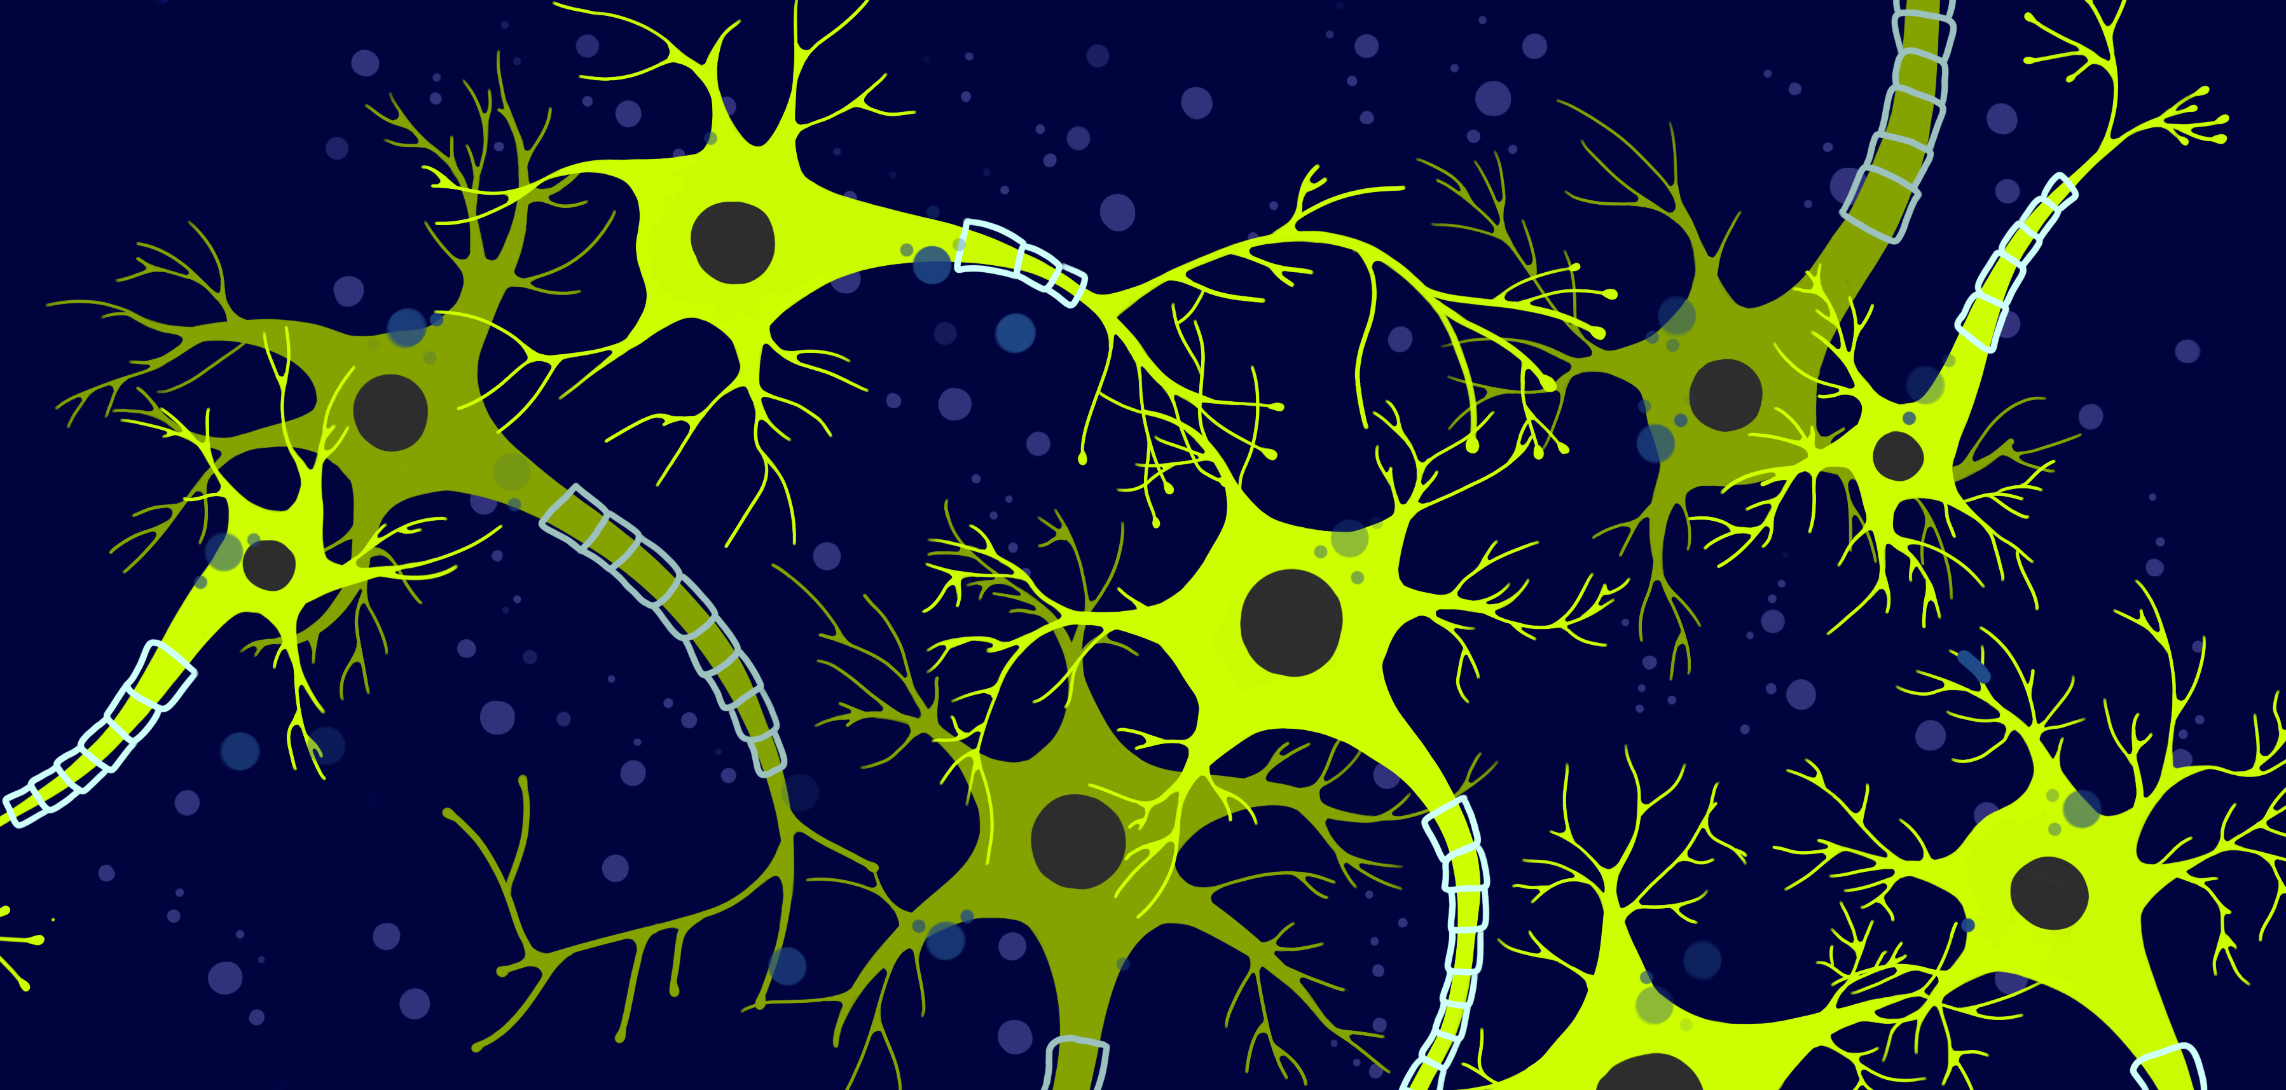
A Neural-Network-defined Gaussian Mixture Model for particle identification applied to the LHCb fixed-target programme (Graziani et al., 2022)
Dina Dervisevic & Amalie T.B Clausen
Advanced Methods in Applied Statistics (AMAS)
March 6, 2024
https://arxiv.org/abs/2110.10259

Slide 2
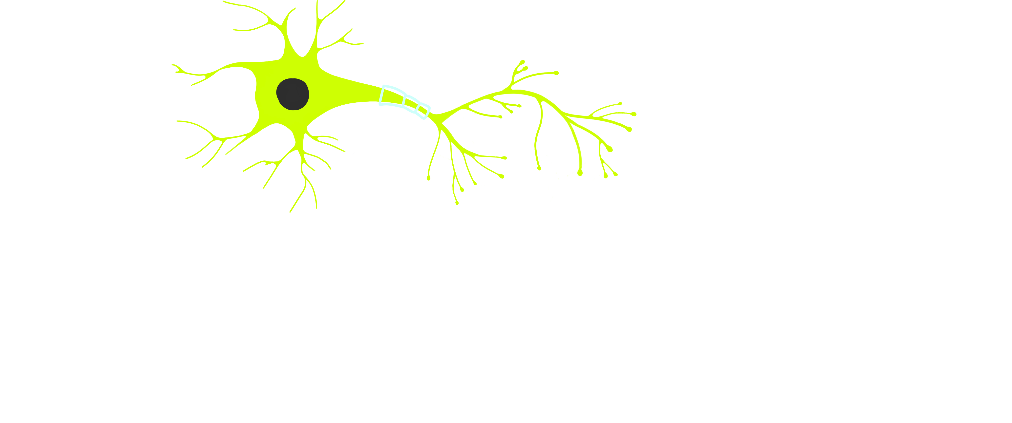
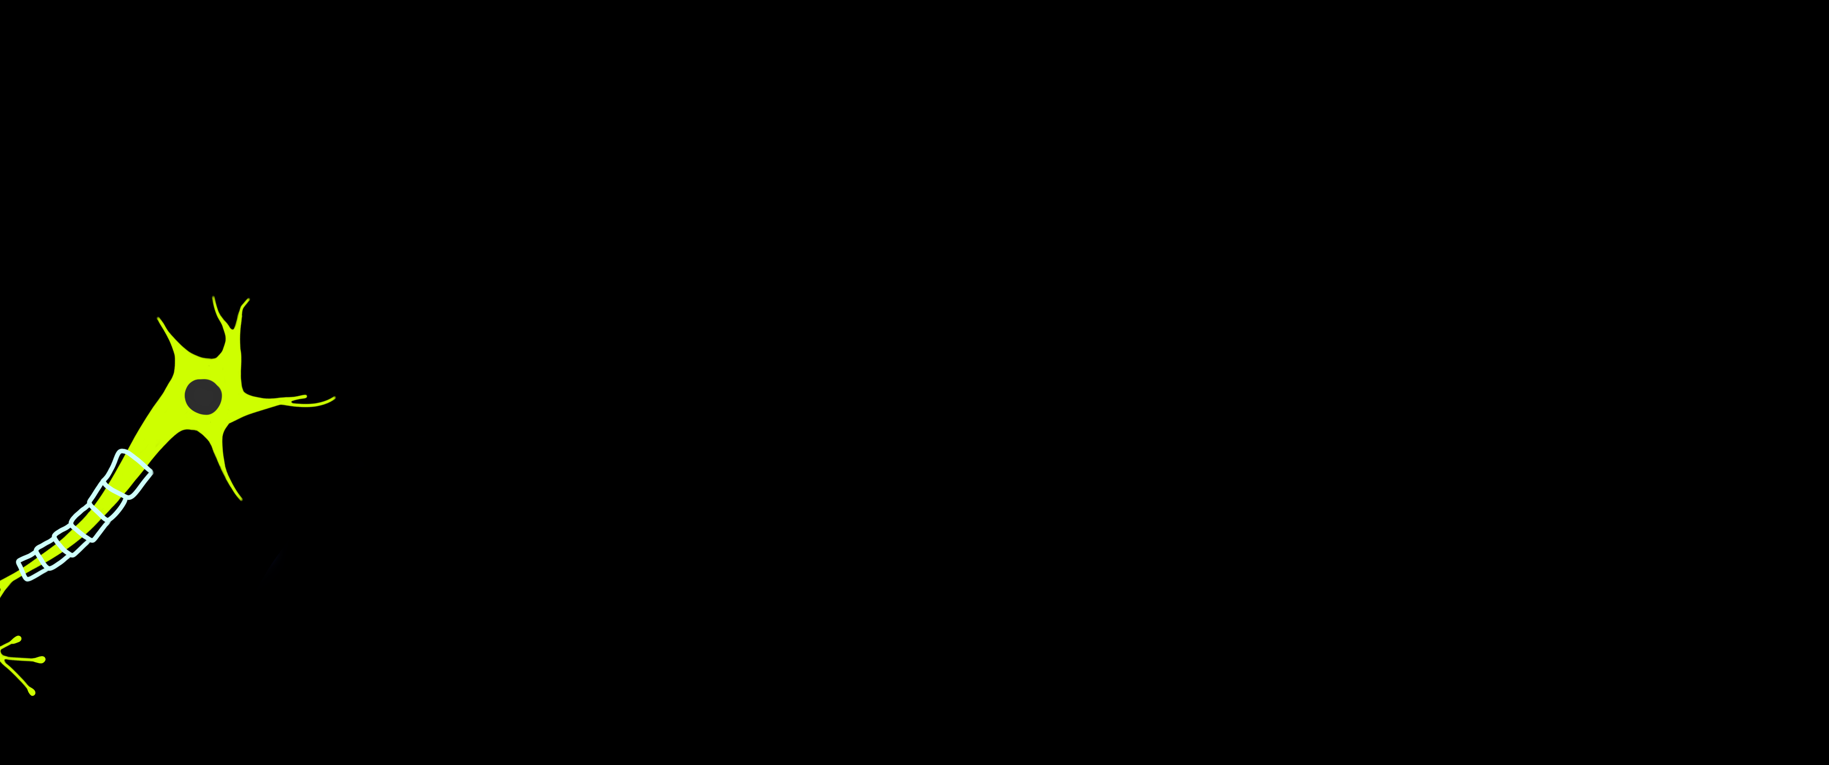
Summary
Explores a data-based method for obtaining particle identification (PID) classifiers.
Very useful for experimental particle physics, where the standard method is through simulations.
Uses a neural-network-defined Gaussian mixture model to describe the distribution of the PID classifiers.
The data-based model provides a more accurate prediction of the PID classifiers’ distribution, than the standard simulation one.
PID classifier:
A mathematical tool derived from detector measurements that tells us the likelihood of a particle belonging to a specific species.
1
Advanced Methods in Applied Statistics (AMAS)

Slide 3

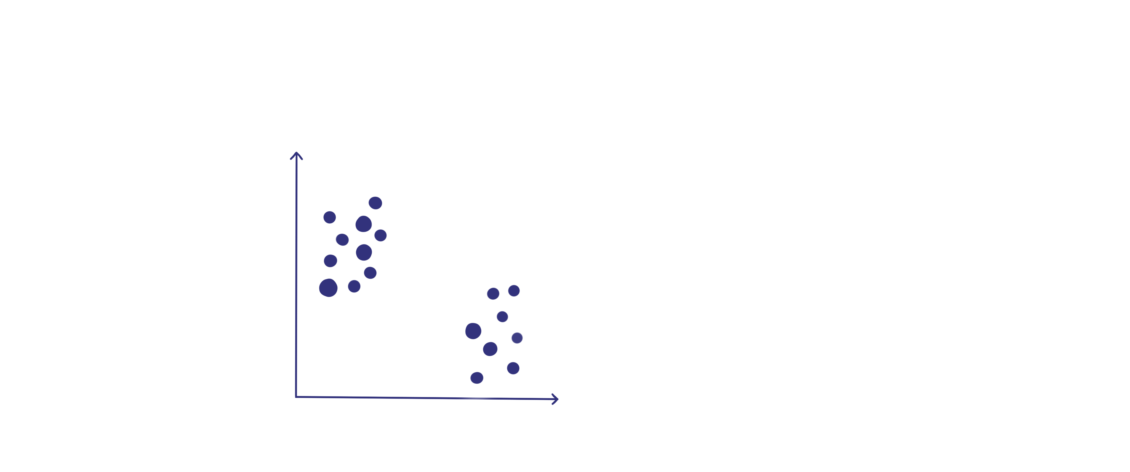
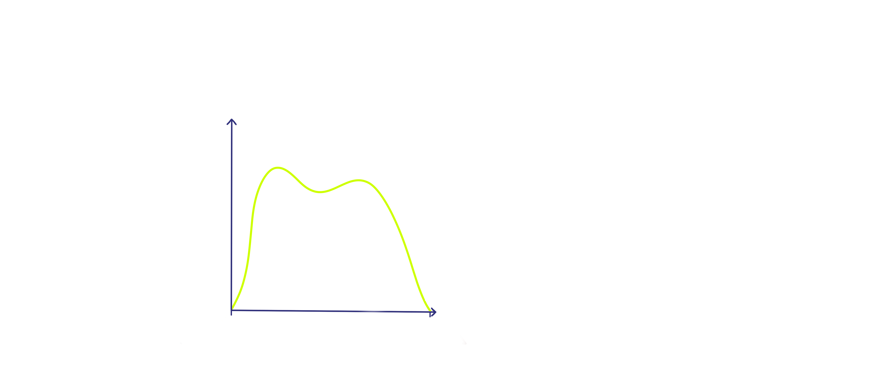
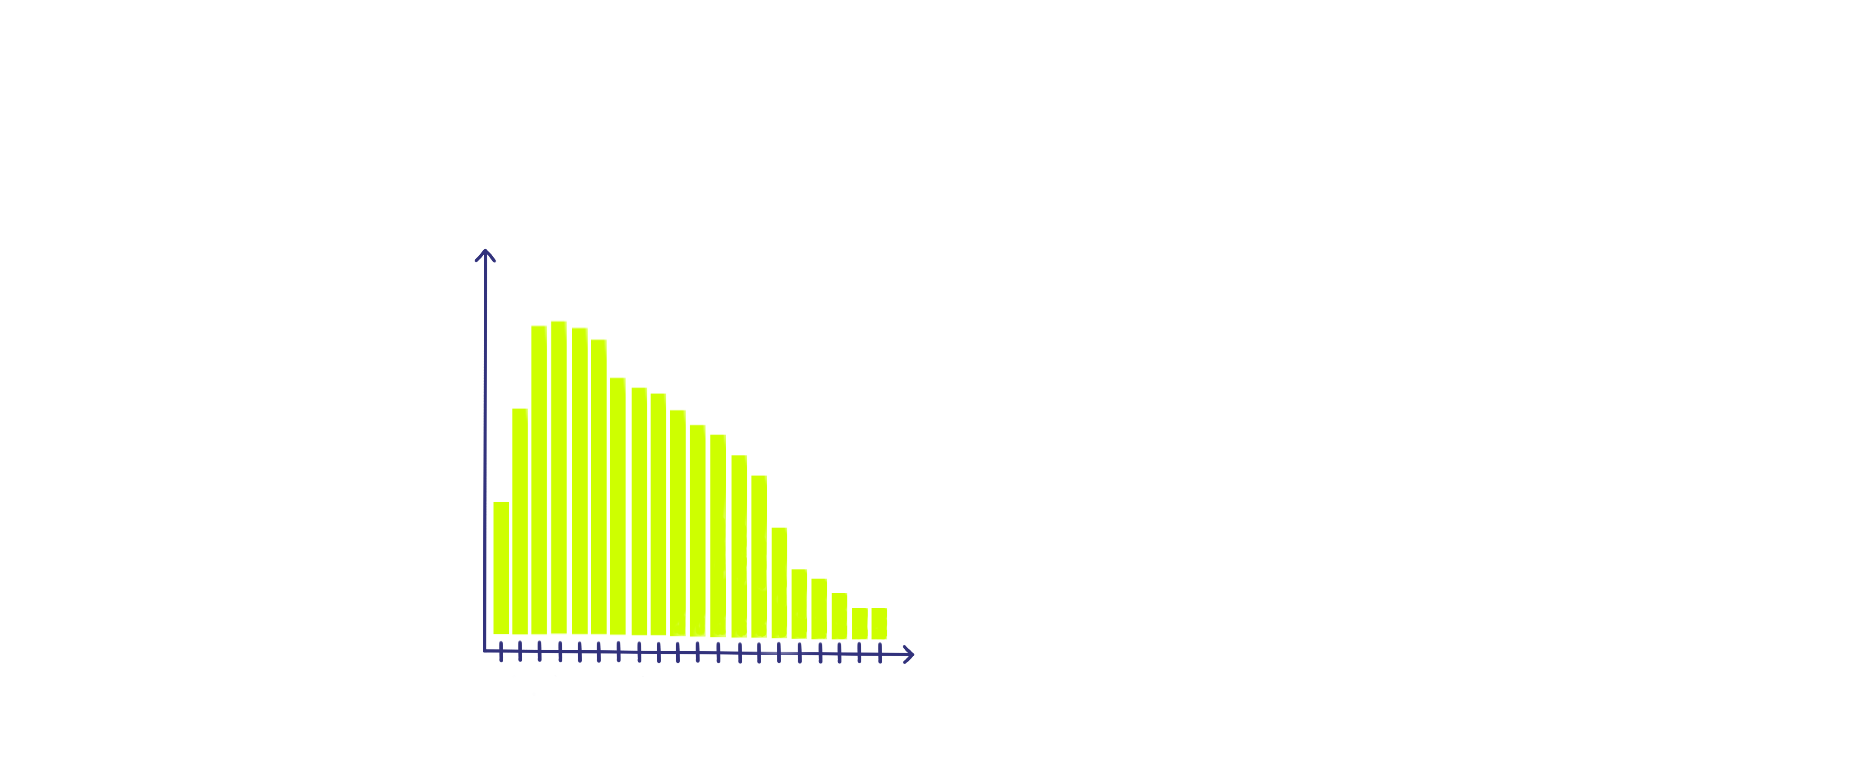
Mixture models
Mixture models used to represent data consisting of multiple subsets.
There are different kinds of mixture models, depending on the probability distributions of the different submodels.
In the article, they use a Gaussian mixture models (GMM).
0
1
Data consisting of 2 different clusters
Beta Mixture Model
Poisson Mixture Model
2
Advanced Methods in Applied Statistics (AMAS)

Slide 4
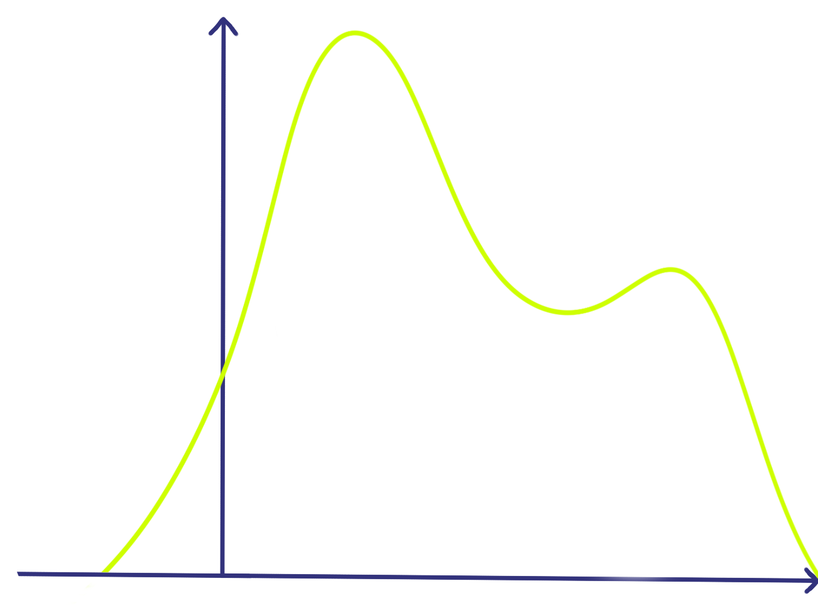
Mixture models
Mixture models are used to represent data consisting of multiple subsets.
There are different kinds of mixture models, depending on the probability distributions of the different submodels.
In the article, they use a Gaussian mixture models (GMM)
0
1
Gaussian Mixture Model
Beta Mixture Model
Poisson Mixture Model
3
Advanced Methods in Applied Statistics (AMAS)

Slide 5
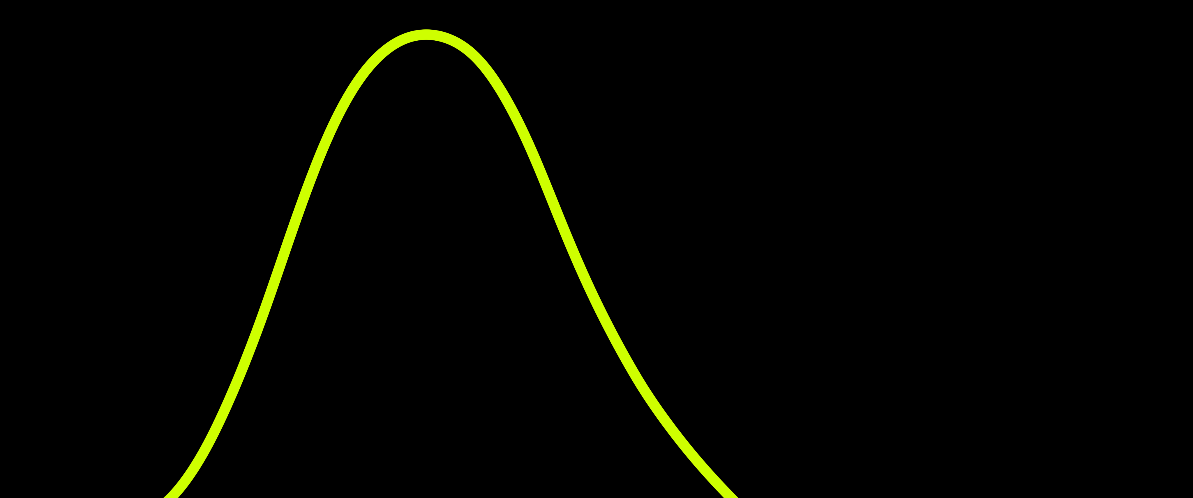
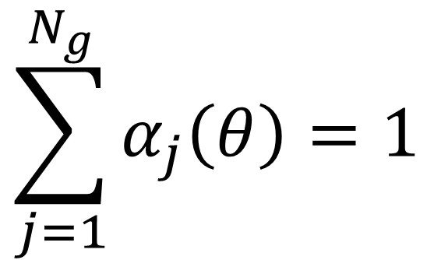
Gaussian Mixture model
Gaussian models are used when different clusters in a dataset have a probability distribution that can be described as Gaussian.
Weights play an important role. They must satisfy:
Number of Gaussians
$$\sum_{j=1}^{N_{g}}{α_{j}\left(θ\right)=1}$$
Weights
4
Advanced Methods in Applied Statistics (AMAS)

Slide 6
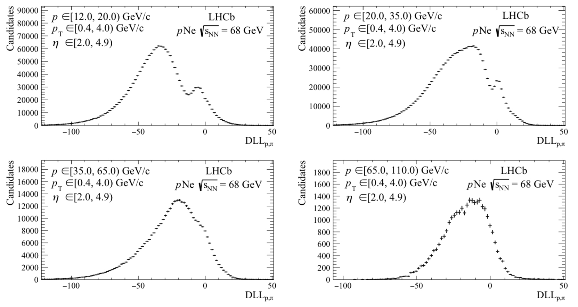
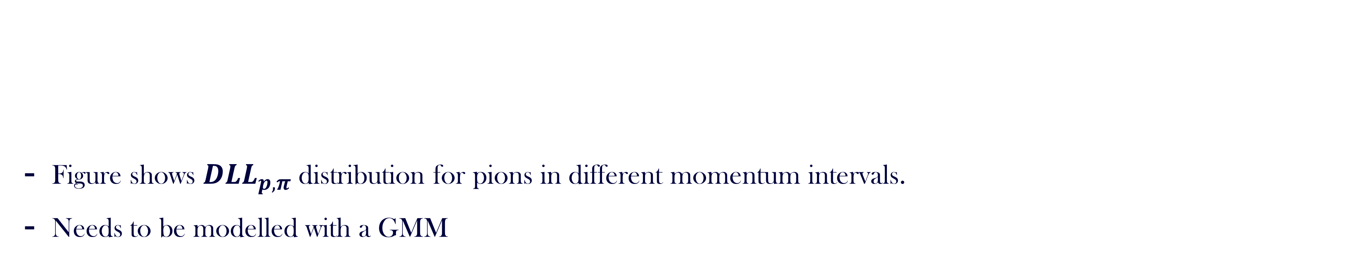

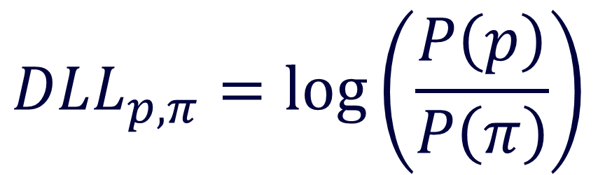
Gaussian Mixture model
Figure shows $DLL_{p,π}$ distribution for pions in different momentum intervals.
Needs to be modelled with a GMM
$$DLL_{p,π}:$$
Stands for Delta Log Likelihood and is a probability based method, used to differentiate between different particles.
Probability of proton
$$DLL_{p,π}=\log\left(\frac{P\left(p\right)}{P\left(π\right)}\right)$$
Probability of pion
Figure 6: $DLL_{p,π}$ distribution for the negative pion in the $K_{S}^{0}→π^{−}π^{+}$ calibration channel reconstructed and selected in the $pNe$ sample in different pion momentum bins.
5
Advanced Methods in Applied Statistics (AMAS)

Slide 7
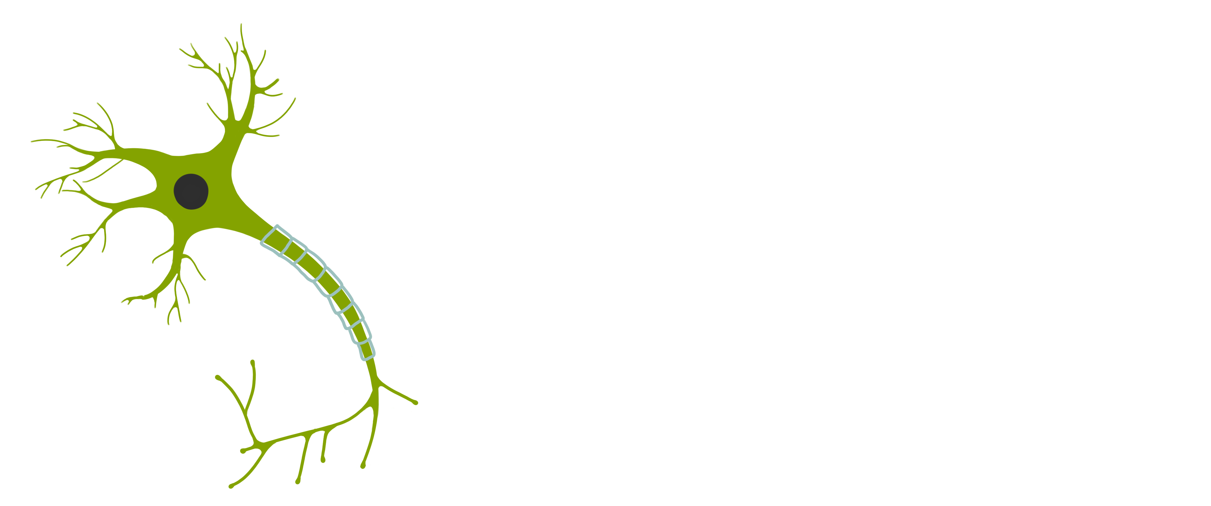
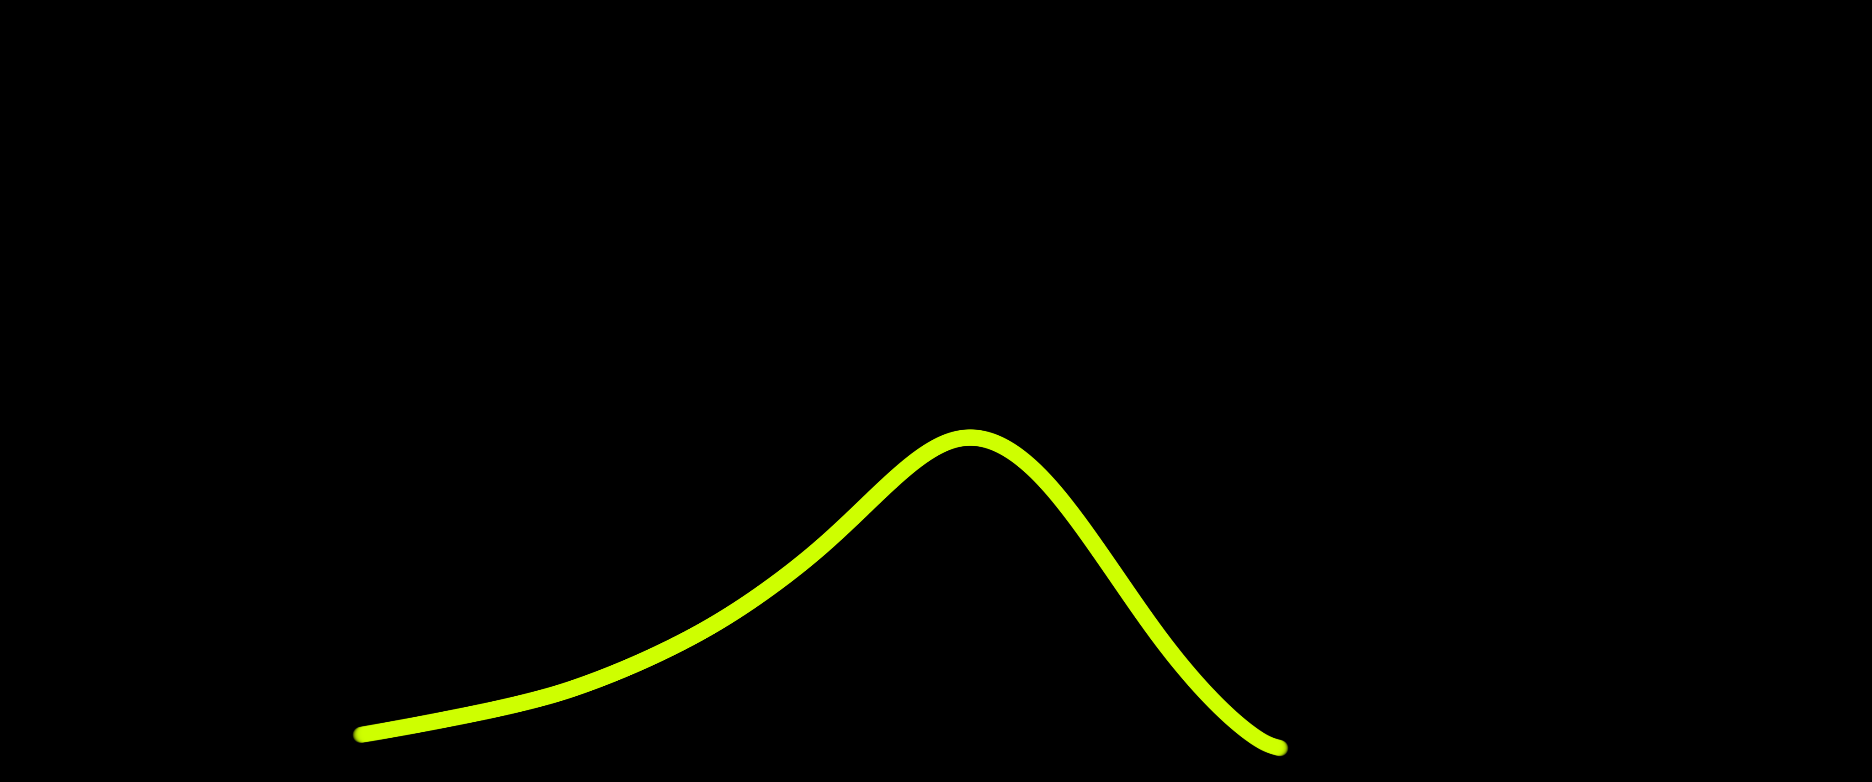
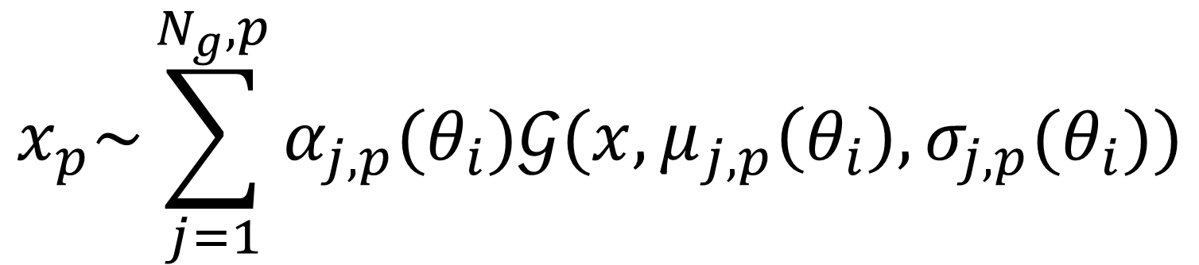
Gaussian Mixture model
Two key aspects are important when constructing a GMM:
The GMM in the article is modelled as:
Number of clusters
Parameters
Standard deviation
Number of Gaussians
Gaussian
$$x_{p}\sim \sum_{j=1}^{N_{g},p}{α_{j,p}(θ_{i})𝒢(x,μ_{j,p}\left(θ_{i}\right),σ_{j,p}(θ_{i}))}$$
Weights
Mean
6
Advanced Methods in Applied Statistics (AMAS)

Slide 8
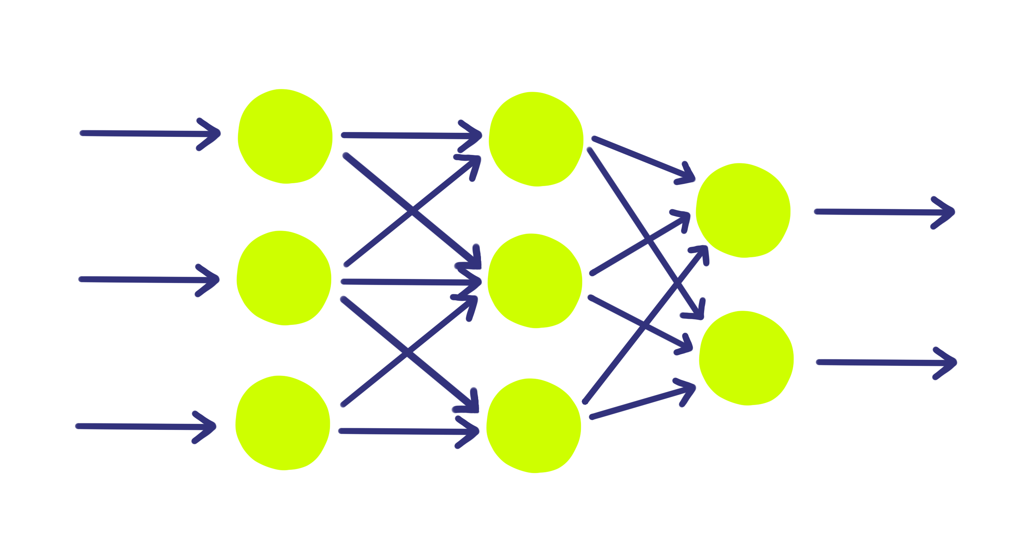
Multi-Layer-Perceptron (MLP) neural network
The fully trained network
Input: Experimental features, which affect the distribution of the PID classifier.
Hidden layers: Performs a weighted transformation and passes the result on to the next layer.
Output: The parameters of the GMM; ⍺, μ, and 𝜎.
Input Layer
Hidden Layer
Output Layer
Outputs
Inputs
Multi-Layer-Perceptron Structure
7
Advanced Methods in Applied Statistics (AMAS)

Slide 9
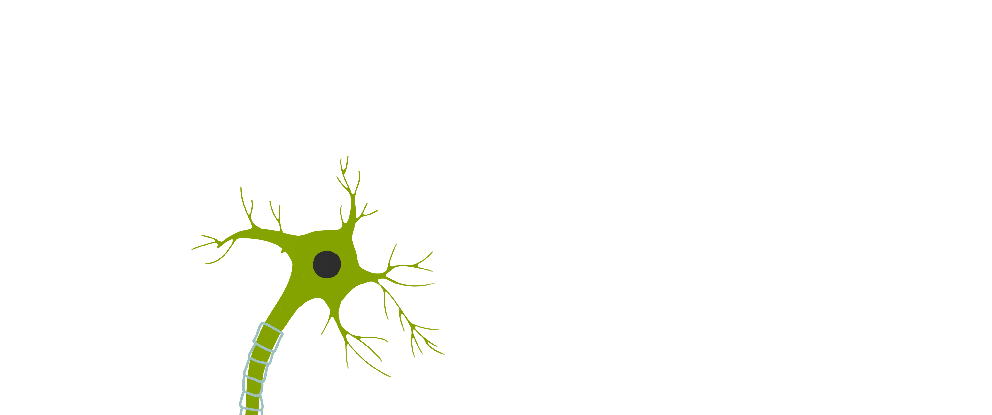
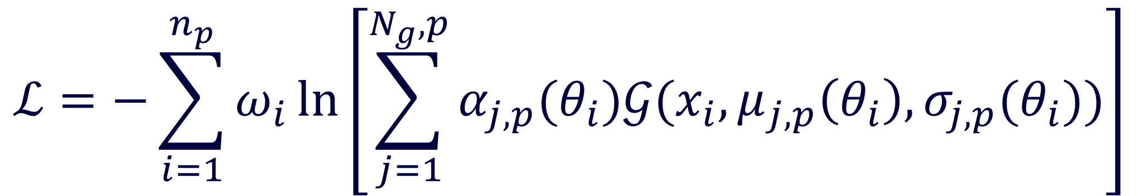
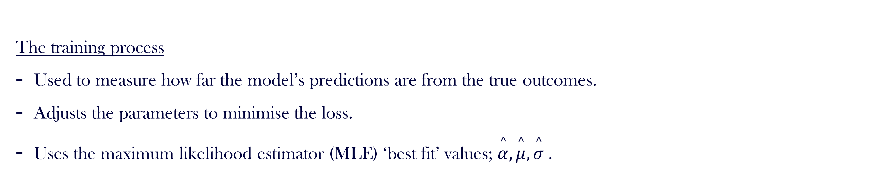
Loss functions
The training process
Used to measure how far the model’s predictions are from the true outcomes.
Adjusts the parameters to minimise the loss.
Uses the maximum likelihood estimator (MLE) ‘best fit’ values; $\overset{^}{α}, \overset{^}{μ}, \overset{^}{σ}$.
Number of Gaussians
Standard deviation
sWeights
Gaussian
$$ℒ=−\sum_{i=1}^{n_{p}}{ω_{i}\ln\left[\sum_{j=1}^{N_{g},p}{α_{j,p}(θ_{i})𝒢(x_{i},μ_{j,p}\left(θ_{i}\right),σ_{j,p}(θ_{i}))}\right]}$$
Mean
Weights
8
Advanced Methods in Applied Statistics (AMAS)

Slide 10
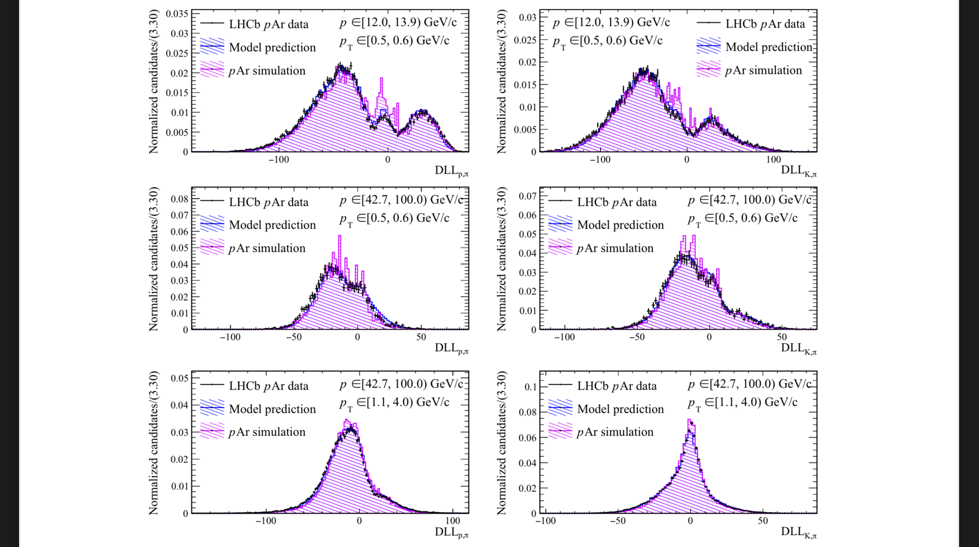
Conclusion
The data-based model is better at modelling the PID distribution than the simulation based model
Comparison of the (left) $DLL_{p,π}$ and (right) $DLL_{p,K}$distributions in $pAr$ data modelled with simulation (violet) and data-based (blue) templates. Adapted from Figure 18
9
Advanced Methods in Applied Statistics (AMAS)

